Slide 1




Welcome to
Green Back India the best opportunity once in a life
Greeback Helthcare Pvt Ltd

Slide 2
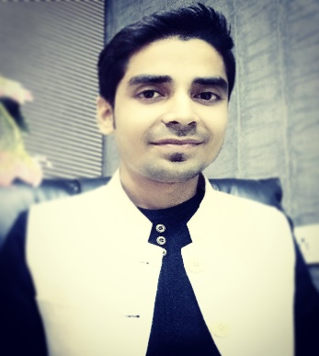


Green Back India Enjoy your healthy life with smile
GREEN LIFE
OUR PRODUCT
Ashutosh Kumar
THE EXCELLENT
INTEGRITY Take pride in everything that is fair, honest and knowledgeable and build trust in every situation | LEADERSHIP Create vision, inspire other and advance the priorities and mission of the organization | INNOVATION & CHANGE Encourage innovation, adapt to change and be willing to take risk
Chief managing director
GREEN POWER
COMMITMENT DETERMINATION Keep pursuing our goals especially when experiencing adversity PASSION FOR SARVICE Show love and compassion for the people we serve and rejoice when their need are meet . | TEAMWORK Cooperate and work together for the common good of the people we serve and the organizations mission
THE EXCELLENT
GREEN POWER
RESULTS Be known for follow-through and responsiveness to our customers needs and achieve agreed –upon outcomes. EXCELLENCE Strive for quality in everything we do | STEWARDSHIP Use all resources efficiently and effectively in order to further the origination's mission to serve people | OPEN CMMUNICATION Encourage directness, candor and diversity so that people and ideas thrive.
ALOE GREEN
THE GREEN GOLD
ALOE GREEN
THE GREEN GOLD
COMPETENCE Thirst for knowledge and self improvement and demonstrate the skills needed to accomplish a chosen task | LOVE FOR EACH OTHER Love is patient, love is kind .it dose not envy, it dose not boast, it is not proud, it is not rude it is not self-seeking, it is not easily angered , it keeps no records of worngs.love dose not delight in evil but rejoices in truth .it always protect, always trusts, always hopes, always perseveres. Love never fails

Slide 3
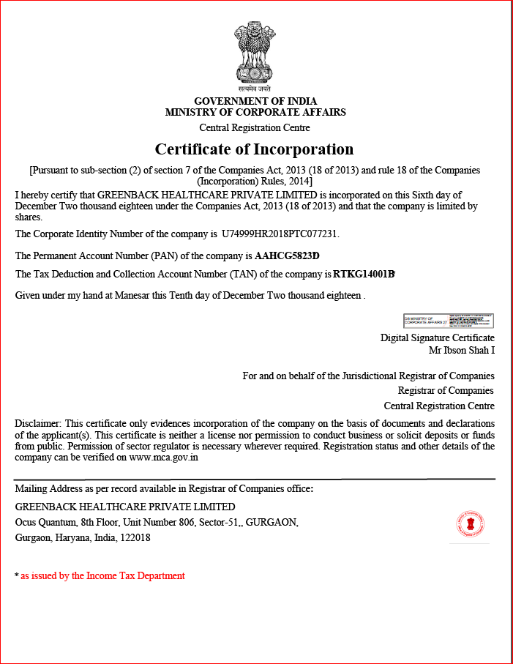
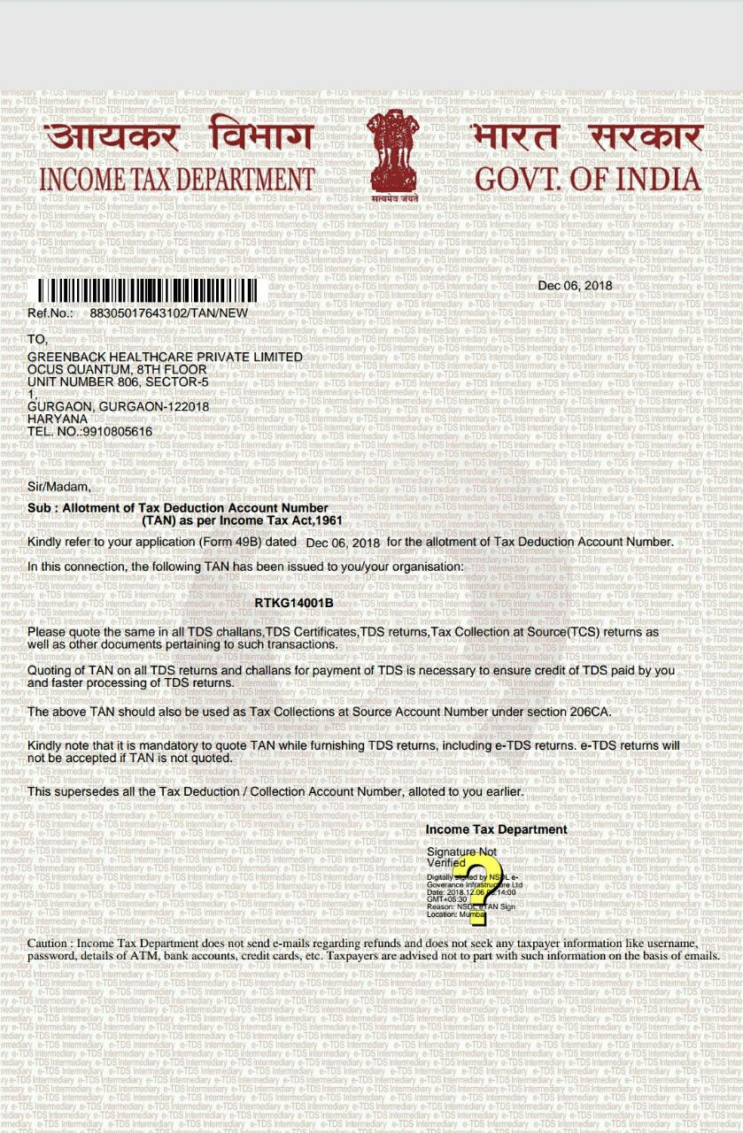
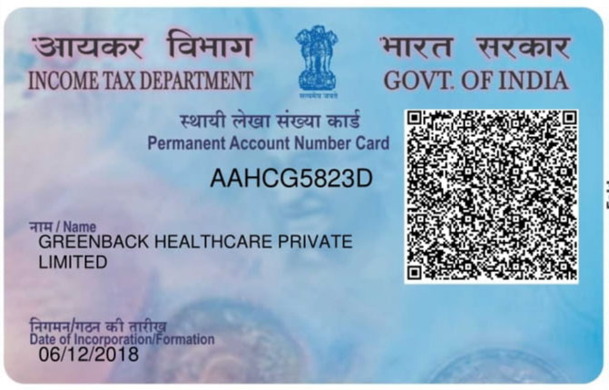
OUR LEGALITY
Green Back India the best opportunity once in a life

Slide 4
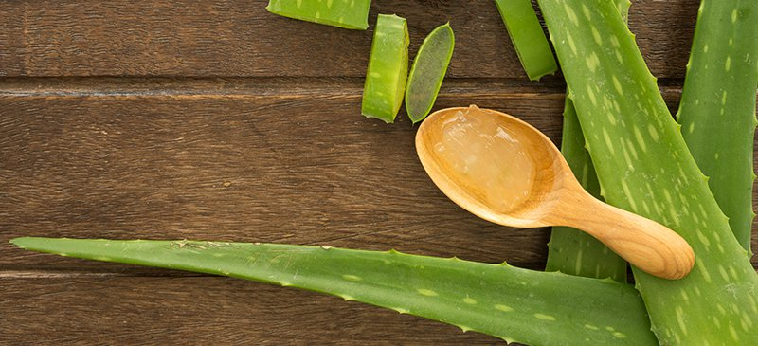
Green Back India the best opportunity once in a life
WORKING SECTOR
Health care
personal care

Slide 5
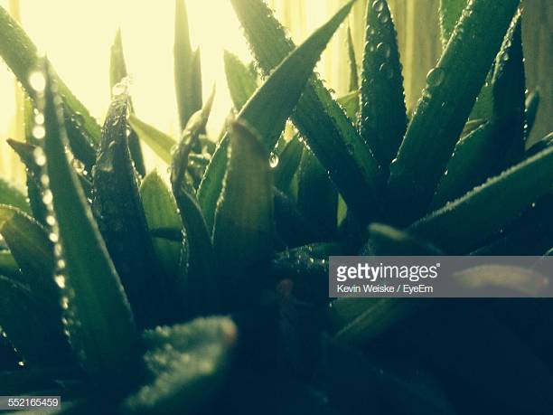

Green Back India the best opportunity once in a life
OUR PRODUCT
Aloe Vera Gel drink "Full Leaf" and rich in pulp. Internal use.
It is cold stabilized by a unique patented process to produce the highest quality juice.
What are the health benefits of drinking Aloe Vera juice?
Alkalinity
Hydration
For constipation
For clear skin
Nutritious boost
Heartburn relief
Digestive benefits
Flushes our Toxins from the Body
What is aloe Vera juice?
The aloe Vera plant is a succulent plant species from the Aloe green. It grows abundantly in tropical climates and has been used for centuries as a medicinal plant. ,Aloe Vera juice is a gooey, thick liquid made from the flesh of the aloe Vera plant leaf. But drinking this healthy elixir in juice form provides you with a number of other health benefits.,Aloe Vera juice is made by crushing or grinding the entire leaf of the aloe Vera plant, followed by various steps to purify and filter the liquid. With a mild, tolerable flavor, the juice mixes easily into smoothies and shakes. This makes aloe Vera juice a practical whole food supplement.
GOOD HEALTH
ALOE GREEN
1000 ml

Slide 6

Green Back India the best opportunity once in a life
The Best Multivitamins for Men/Women
Men’s and women’s bodies have different needs,Men require more of some nutrients and less of others, compared to women. A daily multivitamin can help bridge that gap.
Vitamins are essential to your overall health. They perform many critical roles in your body, from producing energy to ensuring proper function of bodily systems.,Not getting enough of certain nutrients can negatively impact your health and even result in chronic diseases.,Men aged 19–70 need to make sure to get enough of the following vitamins and minerals
Vitamin A: Necessary for skin, eye and immune health.
Vitamin C: Essential for your immune system and collagen production.
B vitamins: Involved in energy metabolism and red blood cell production.
Calcium, magnesium, vitamin D, vitamin K and zinc: Vital for bone health.
Vitamin E and selenium: Help protect your cells from damage
Nutrients are essential for your health, but many people don’t get enough of the recommended essential vitamins and minerals through diet alone
GREEN POWER
500 ml
Multivitamin Booster
One Goal
One Passion
One team

Slide 7

Green Back India the best opportunity once in a life
THE EXCELLENT
Excellent mousturing for all skin type
A fast absorbing, light gel-cream that gives a mattifying effect. Leaves skin feeling cooled, fresh, hydrated and soft.
Q-100 g

Slide 8
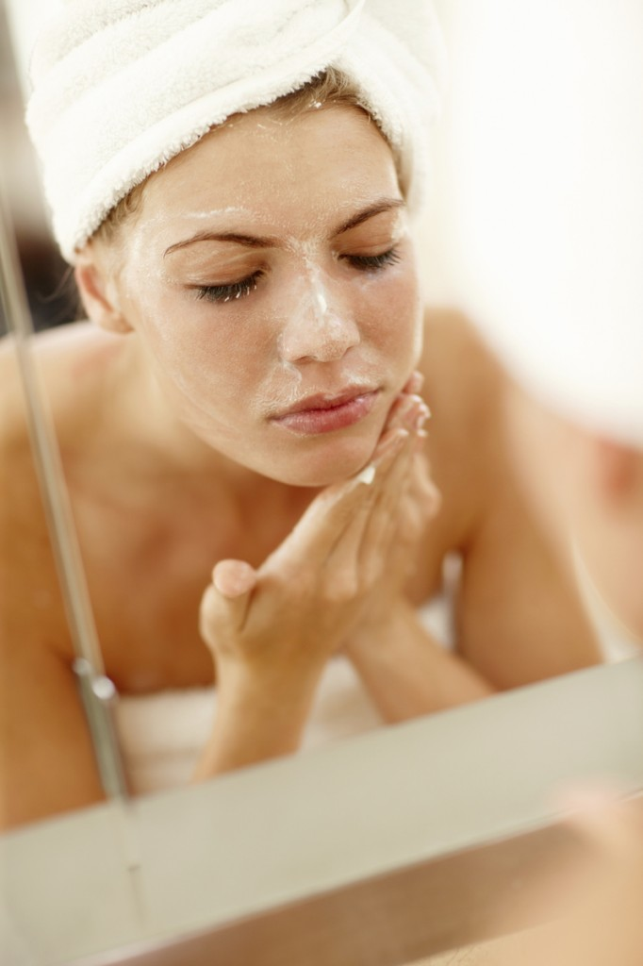

Green Back India the best opportunity once in a life
Effects: moisturizing, whitening, firming skin, shrink pores, oil control, brighten skin, moisturize the skin
Aloe Vera essence ,moisturizing shrink pores containment acne natural repair
THE GREEN GOLD
Q-100 g

Slide 9
Green Back India the best opportunity once in a life
GREEN LIFE
500 ml
GREEN LIFE
Detailed Description:
Green Life for women complex is a daily supplement specifically formulated for women. Can assist the body with: Immune function support. Urogenital health support. Gastrointestinal health support. Energy support. Efficacy of support may vary between users,
For Women Complex
For Women special combination of vitamins and minerals to help women stay healthy. It can aid the immune system's functions, and gastro-intestinal and uro-genital health too.

Slide 10

Green Back India the best opportunity once in a life
Greenback health kit worth of 6500 Rs only
Enjoy your healthy life with smile

Slide 11



Green Back India the best opportunity once in a life
One Goal
One Passion
One team

Slide 12

Green Back India the best opportunity once in a life
Simple and beneficial Ways To Acquire Quick Leads For Multi-level Marketing Business
INTEGRITY Take pride in everything that is fair, honest and knowledgeable and build trust in every situation | LEADERSHIP Create vision, inspire other and advance the priorities and mission of the organization | INNOVATION & CHANGE Encourage innovation, adapt to change and be willing to take risk
COMMITMENT DETERMINATION Keep pursuing our goals especially when experiencing adversity PASSION FOR SARVICE Show love and compassion for the people we serve and rejoice when their need are meet . | TEAMWORK Cooperate and work together for the common good of the people we serve and the organizations mission

Slide 13
Green Back India
opportunity once in a life
RESULTS Be known for follow-through and responsiveness to our customers needs and achieve agreed –upon outcomes. EXCELLENCE Strive for quality in everything we do | STEWARDSHIP Use all resources efficiently and effectively in order to further the origination's mission to serve people | OPEN CMMUNICATION Encourage directness, candor and diversity so that people and ideas thrive.
COMPETENCE Thirst for knowledge and self improvement and demonstrate the skills needed to accomplish a chosen task | LOVE FOR EACH OTHER Love is patient, love is kind .it dose not envy, it dose not boast, it is not proud, it is not rude it is not self-seeking, it is not easily angered , it keeps no records of worngs.love dose not delight in evil but rejoices in truth .it always protect, always trusts, always hopes, always perseveres. Love never fails
One Goal
One Passion
One team

Slide 14



Green Back India the best opportunity once in a life
Joining package Rs 6500
First Joining Ratio 2:1
Matching Income 700/- Par Pair
Daily Capping Rs- 14,000/-
Weekly Earning Rs- 98,000/-
Monthly Rs- 4,20,000/-
One Goal
One Passion
One team

Slide 15
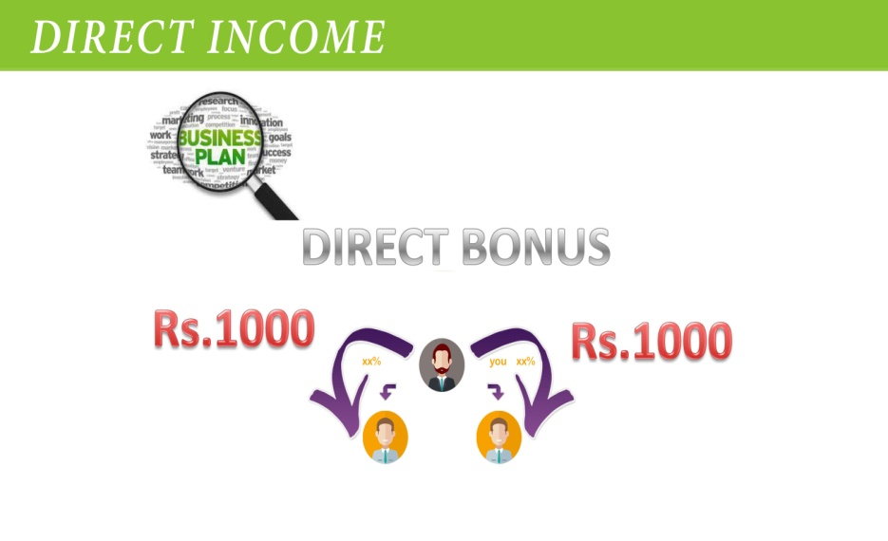
Green Back India the best opportunity once in a life
One Goal
One Passion
One team
Direct Referral 1000 RS /- Par Signal ID
On unlimited depth
One Goal
One Passion
One team

Slide 16




Green Back India the best opportunity once in a life
LEVEL | PAIR | REWAED
1 | 10 | 2,500
2 | 25 | 6,000
3 | 50 | 12,500
4 | 100 | 25,000
5 | 200 | 50,000
6 | 500 | 1,25,000
7 | 1000 | 2,50,000
8 | 2000 | 5,00,000
9 | 5000 | 12,50,000
10 | 10000 | 25,00,000
11 | 20000 | 50,00,000
12 | 50000 | 1,00,00,000
13 | 100000 | 2,50,00,000
14 | 200000 | 5,00,00,000
15 | 500000 | 12,00,00,000
Royalty Income coming soon
No time Bound No deduction

Slide 17


Green Back India the best opportunity once in a life
TAX DEDUCTION | Only 10%
5% Admin Charge
5% T.D.S
S No | Direct Member | Pool Income(every Month)
01 | 3 to 9 | 5% of CTO for life time
02 | 10 to 15 | 3% of CTO for life time
03 | 16 and above | 2% of CTO for life time
Offer:- | Refer 22 ID direct, till 30 January and get every month 7% amount of the company turnover *
For any assistance you can call our help line number 011 -244201442,447,452
For more details visit on our website www.greenbackindia.com

Slide 18



Green Back India the best opportunity once in a life
A/C NO. | 918020112943949
IFS CODE | UTIB0000846
Company name:- Greenback healthcare Pvt Ltd
A/C NO. | 201002964837
IFS CODE | INDB0000401

Slide 19
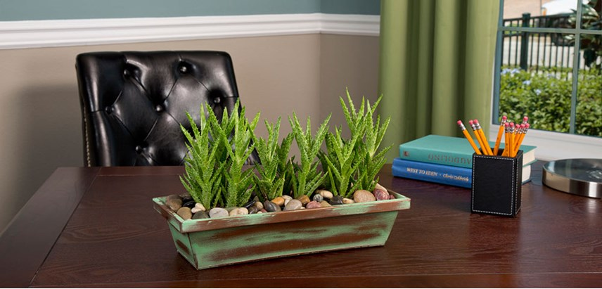
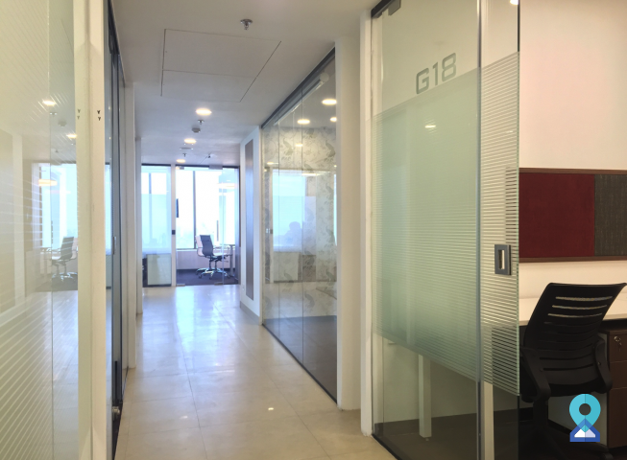
Green Back India the best opportunity once in a life
Thank you
Office Add -Unit No - 806, Floor No.- 8, Ocus Quantum,
SectOR-51,Gurugram, Haryana 122001
Office No
+91-124-4201442, 447, 452
ID Active and pin Related query:7410859067
Whatsapp No.8901085906
Help Desk No.9319739616
Send us email for any Information
Support@greenbackindia.com
One Goal
One Passion
One team

